Slide 1
Introduction to Java
Why learn Java
What is Java & OOP
Java Syntax
Requirements for running Java
Vivienne O Ansah
Notes:
Summary

Slide 2
Why Java
Develop any program
Write Once Run Anywhere
Object-Oriented
Platform-Independent
Notes:
Web applications, desktop, Frameworks, Big Data
Bytecode can be executed on any machine with JRE.
Enables you to create OOP to reuse and secure code.
Code written on any platform can run and any machine.

Slide 3
What is java
Java is an object-oriented, cross platform, multi-purpose programming language.
Java can be used to develop Web applications, Frameworks, Android development, Continuous Testing and Big Data.
Java is everywhere (Banking, Retail, IT, Stock Market)

Slide 4
What is Object Orientated Programming?
1. What attributes does this superhero have?
Name
Superpower
Strength
2. Are there other types of superheroes?
Batman
Super Woman
Spider-man
3. What do they have in common and in what ways do they differ?
Walk()
Run()
Jump()
Notes:
The world is made up of objects and it’s a natural way to program.
When programming with objects, the properties and methods that work on the objects that are all grouped together.

Slide 5
What is Object Orientated Programming?
A way of breaking down problems and its functionality at the same time.
An object, which is based on a class, is a container of attributes(data) and methods(function).

Slide 6
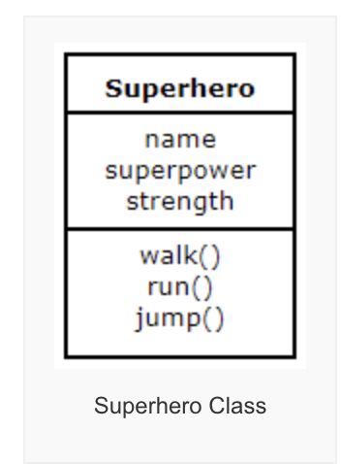
Classes and Objects
Let’s consider a class class called Superhero.
They allow variables and methods to be isolated to specific objects instead of being accessible by all parts of the program.
Attributes
Methods
Notes:
Every superhero inherits all the attributes and methods of the parent class.
Methods can be changed using Polymorphism

Slide 7
Writing Java programs
Install the Java JDK (Java Development Kit) from Oracle website
Java programs can be written using a text editor such as :
Atom
Visual Studio Code.
They can also be written using and IDE (Integrated Development Environment) such as
NetBeans
IntelliJ
Eclipse
BlueJ
Android Studio

Slide 8
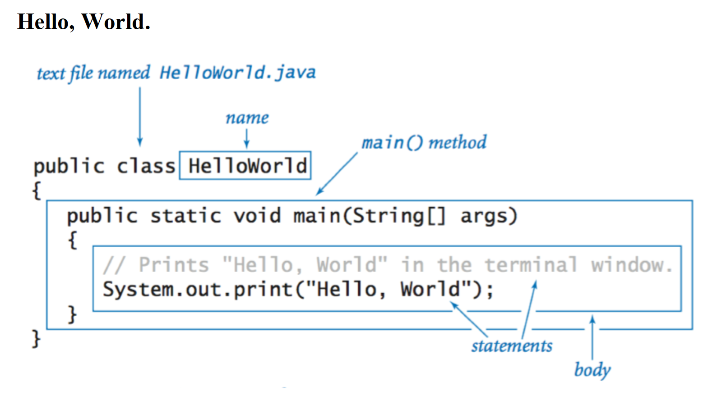
Java syntax
Notes:
Every Java program main class name must match the file name.
All other class within the java project must be called from the main method.

Slide 9
Q & A Fill in the blanks
Java is Platform Dependent ? True or False
An ___________ is a variable defined within a class to store a value.
An _____ is an instance of a class.
Every Java file must have a ____ extensions.
Programs written in Java can be integrated into Websites? True or False
Object, Attribute, Class, Java

